Slide 1
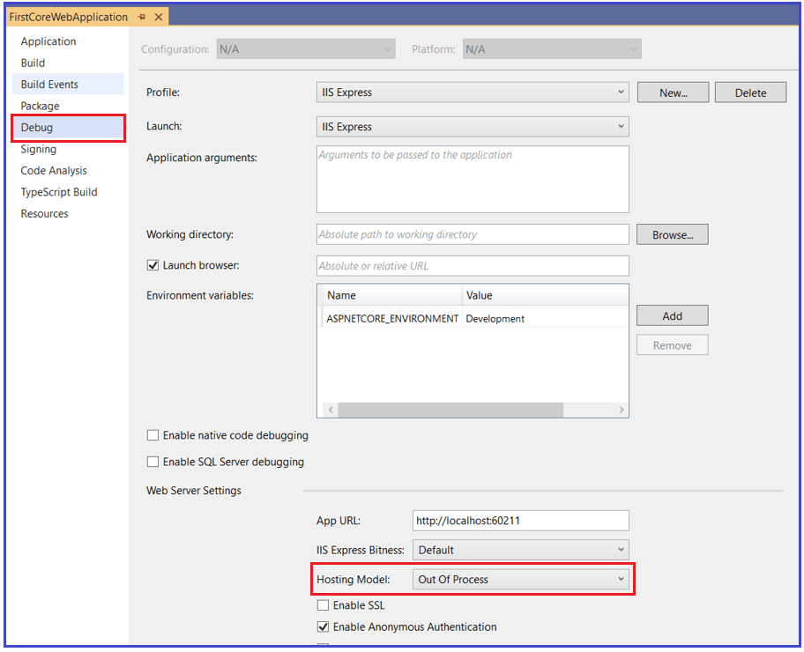
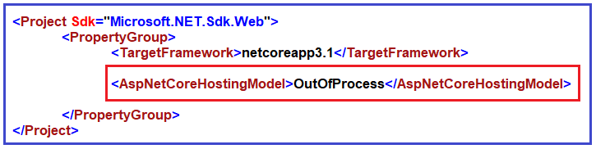
How to Configure the OutofProcess Hosting in ASP.NET Core Application?
Way1: In this case, you just need to add the <AspNetCoreHostingModel> element to the applications project file with a value of OutOfProcess as shown below.
Way2: Specify the Hosting Model as OutOfProcess in the Project Properties
To do so, right-click on your project in the solution explorer and click on the Properties option from the context menu which will open the Project Properties window. In this window, select the Debug tab and then select the Hosting Model value as OutOfProcess as shown in the below image.

Slide 2
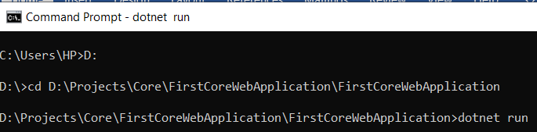
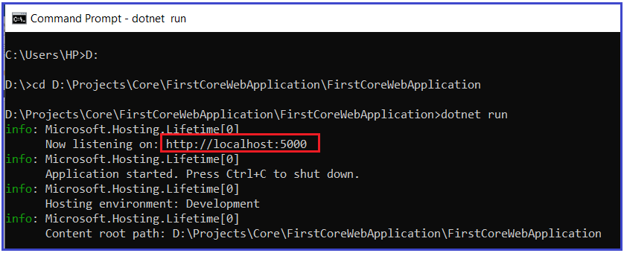
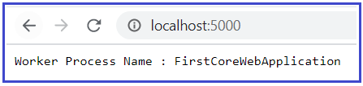
To confirm this, open the command prompt and run the application as shown in the below image. As my First, you need to change the directory to the folder which contains your asp.net core application. My project is present in the “D:\Projects\Core\FirstCoreWebApplication\FirstCoreWebApplication” folder so I change the current directory to my project file and then use the dotnet run command.
Now open the browser window and navigate to the following URL which is shown in the command prompt. In my case, the following is the.
http://localhost:5000
And here you will see the worker process name as your application name as shown below
So, in this case, Kestrel is the only server that will handle and process the incoming HTTP Request. The following code of the Startup class displays the worker process name.

Slide 3
if (env.IsDevelopment())
{
app.UseDeveloperExceptionPage();
}
app.UseRouting();
app.UseEndpoints(endpoints =>
{
endpoints.MapGet("/", async context =>
{
await context.Response.WriteAsync("Worker Process Name : " + System.Diagnostics.Process.GetCurrentProcess().ProcessName);
});
});
}}}

Slide 4
profile | Default | Server | Number of Server
Http | InProcess | Kestrel server | 1
IISExpress | InProcess | IIS Express | 1
IISExpress | OutOfProcess | External(IIS) Internal Kestrel | 2
Http | OutOfProcess | Kesteral | 1

